Slide 1

My transition book
Year 5
Transition Booklet
2026 - 2027
Be Curious, Be Inspired, Belong.

Slide 2


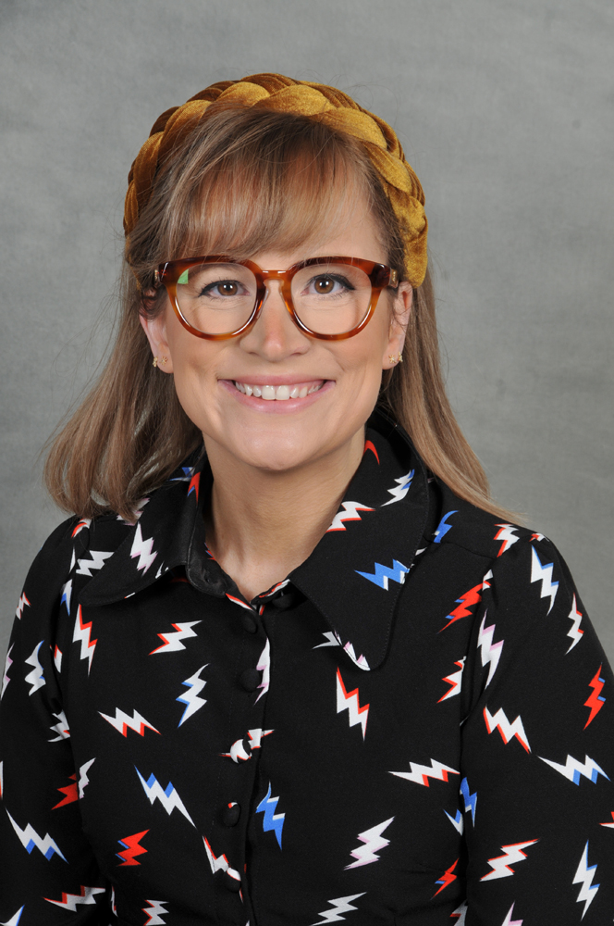
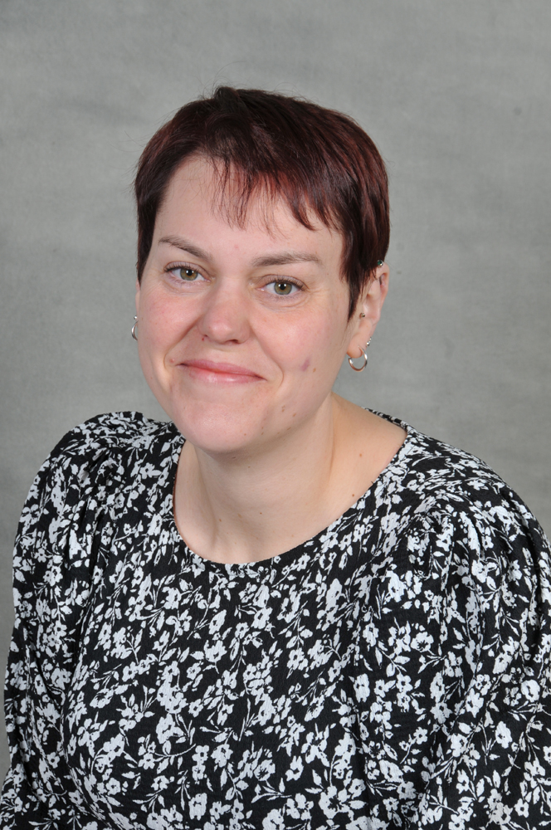
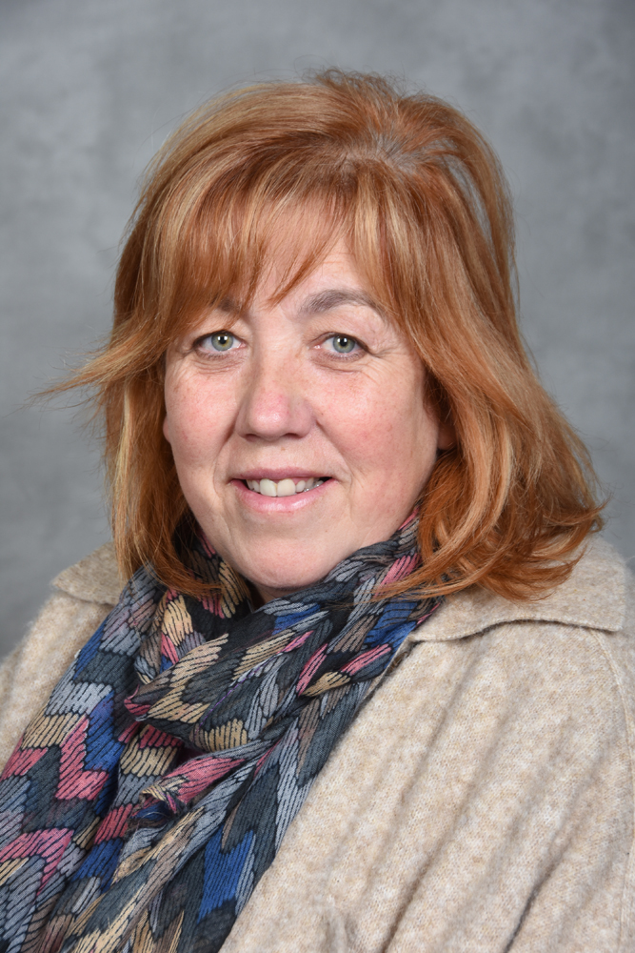
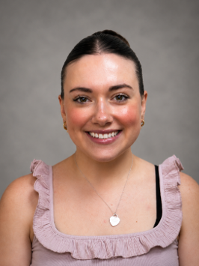
Welcome
Our Holy Trinity Team
Mrs Wakefield
Mrs Fox
Jane
Miss Anderson - Teacher
Be Curious, Be Inspired, Belong.

Slide 3
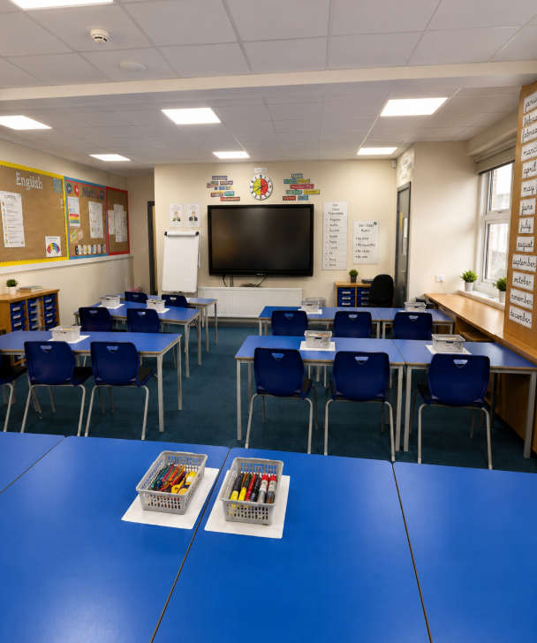


Your Classroom
Next year will look like…
My classroom
and other classrooms
Where I will do my learning
Be Curious, Be Inspired, Belong.

Slide 4

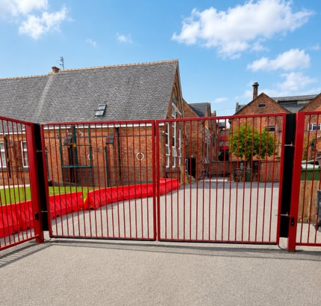
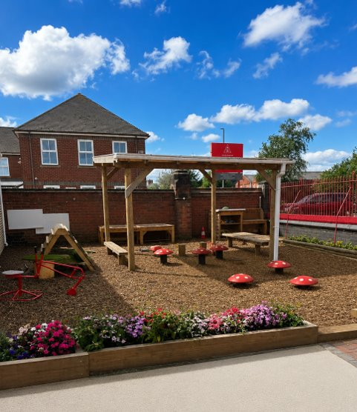
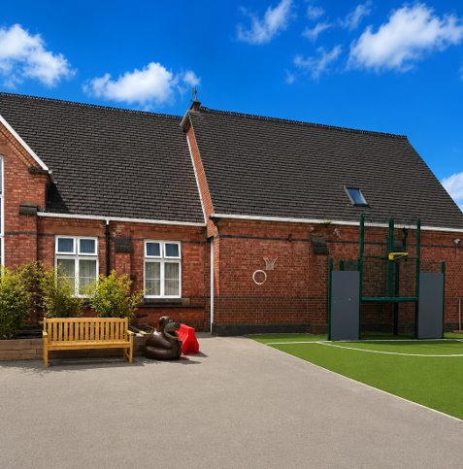
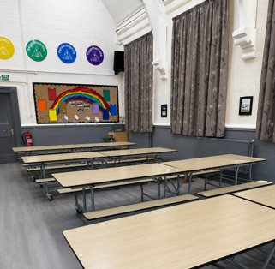


Around School
Next year will look like…
My adults will drop me off at the red gate
The playground
The dinner hall
The toilets
Be Curious, Be Inspired, Belong.

