Slide 1
Koinonia and Love
Values Day
23.10.23
The children had a lovely day celebrating our Values Day. They took part in lots of activities, which included Prayer Spaces, a local walk in our community, creating art work for the community centre and creating a present for their partner reading class to say a big thank you and to show they care. ☺

Slide 2
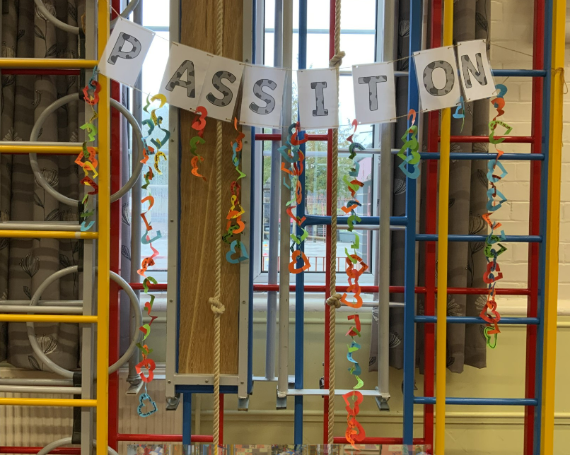
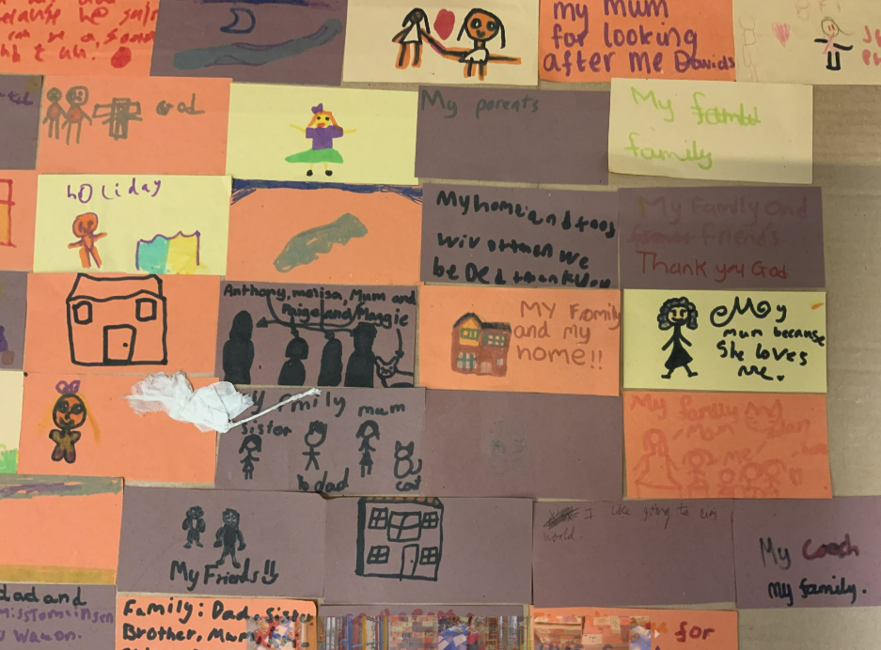
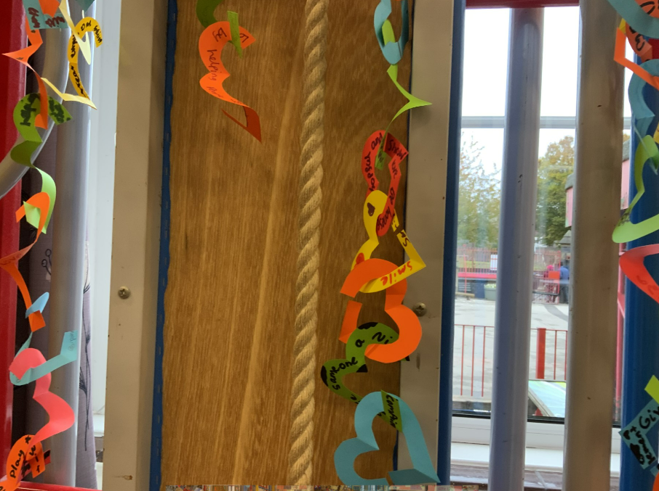
Prayer Spaces with Riverside Church
The children really enjoyed their Prayer Spaces activity with Riverside Church. First they learned about their value of Koinonia and looked at different images of their local community. They then discussed things that they were grateful for and wrote on a ‘brick’ to add to their cardboard Holy Trinity school.
After this, the children completed an activity linked to our value of Love, where the children had to think about how they could show Love in their everyday lives and wrote on a small heart this act. They were also each given a challenge to complete an act of kindness over the next week.

Slide 3
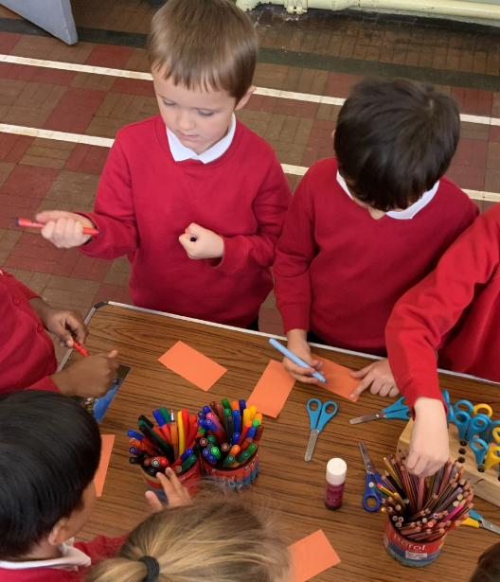
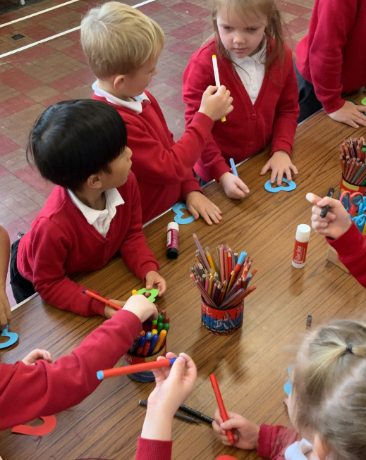
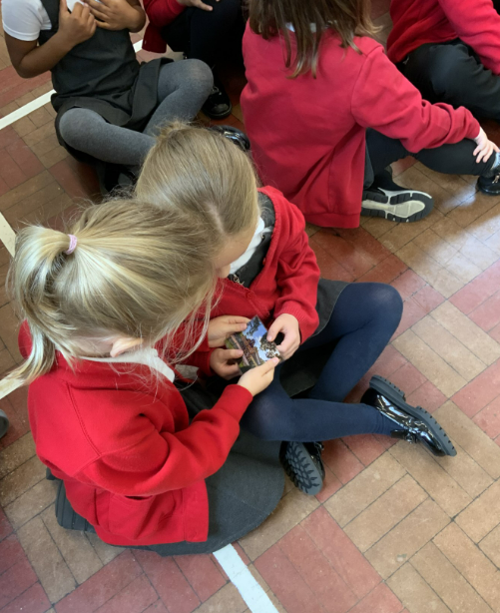
Year 1 – Prayer Spaces
Year 1 enjoyed taking part in the Prayer Spaces Riverside Church provided. They discussed their local community and how think links to our value of Koinonia and then they chose an act of kindness that they could pass on to others.

Slide 4
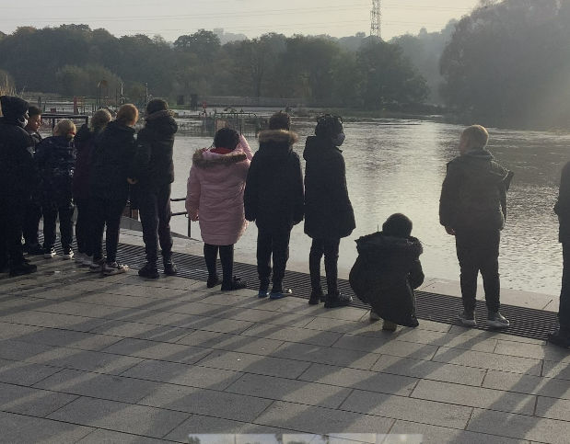
Year 3 and 4 - Koinonia
Year 3 and 4 enjoyed their walk into Burton to look at our local community and how we could support it. They were very shocked when they saw the flooding and asked lots of questions to learn more about it. They enjoyed looking at the bridge in preparation for their art work for Wetmore Community Centre.
When we got back to school, Year 3 and 4 discussed how looking at our local community links with Koinonia and how they could show Koinonia when they were creating their art work.

Slide 5
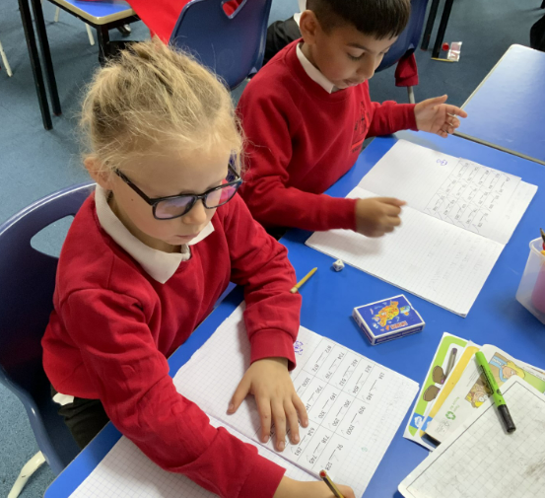
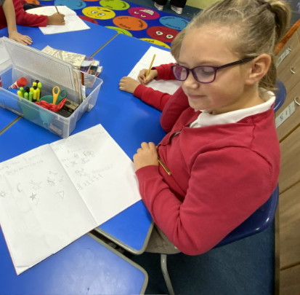
Year 3 – Love - Psalm 23
Year 3 enjoyed learning about Psalm 23 which links to our value of Love. They created a story map so that they could retell Psalm 23 and discussed how it links with our value of Love in school. They also created sheep puppets for Nursery children to show they cared. ☺
These are some of the responses the children had about Psalm 23 –
“The shepherd is God because he looks after his sheep”
“It links to love because God loves us and we should show love towards other people.”
“The shepherd guides and God guides us.”

Slide 6
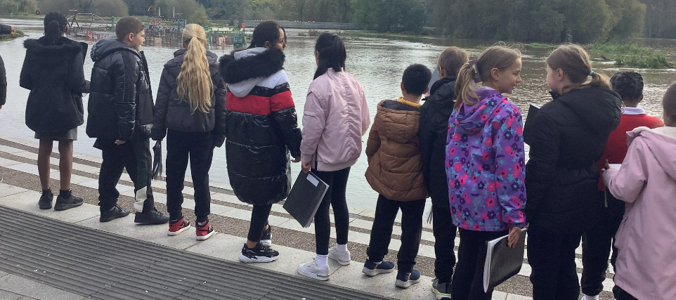
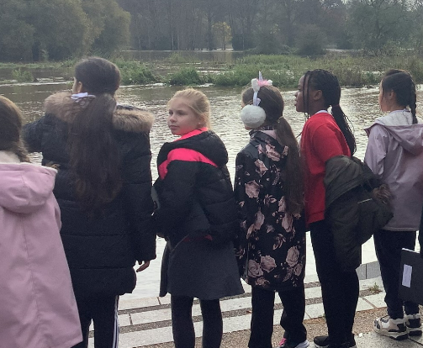
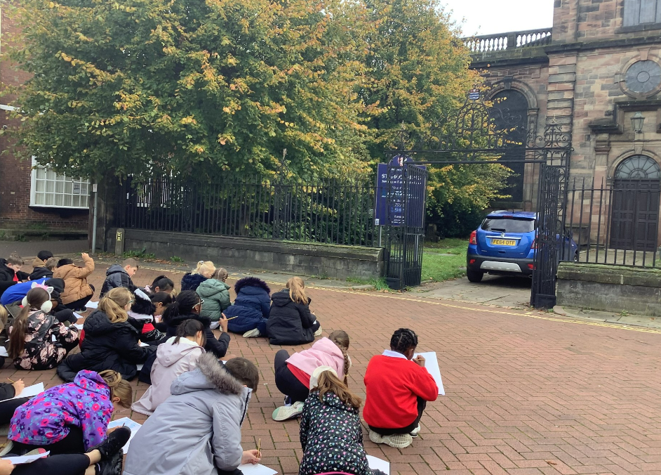
Year 5 - Koinonia
Year 5 enjoyed their walk around the local community and were shocked to see how far up The Washlands the water had risen. “What if it continues to rise?” AZ.
The children also enjoyed sketching St Modwen’s church ready to take part in an art project for the community centre, where they will be recreating landmarks from their local area.

Slide 7
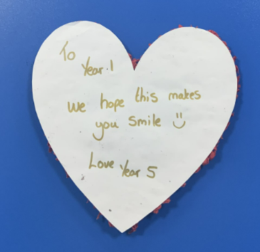
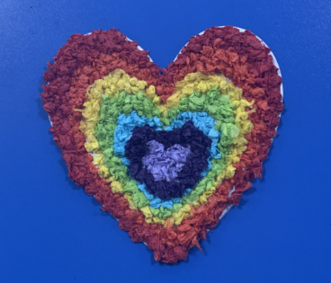
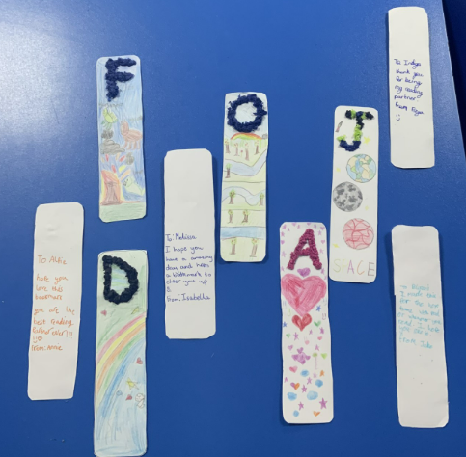
Year 6 - Love
To celebrate our value of love, Year 5 have made gifts for Year 1 (our partner reading class.) The children have made a love heart with a special message on the back for Year 1 to hang in their reflection area and have also made a bookmark for their individual partner. Year 5 thought carefully about how they would decorate them so that their partner reader would love their gift.
“I’m going to add dinosaurs to mine because my partner told me that they love all things dinosaurs!” SH

Slide 8
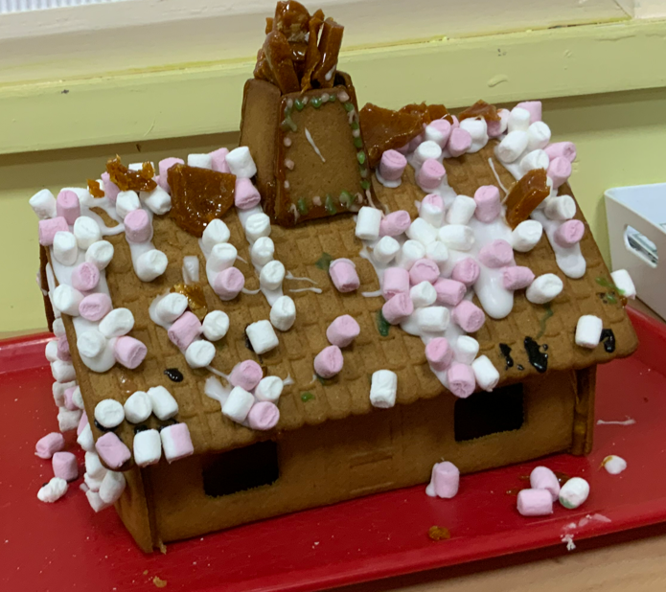
Year 6 - Love
To link to our value of Love, each class created a gift for their partner reading class. To show that they cared and to say a big thank you for being reading partners, Year 6 created a lovely gingerbread house for Year 2. ☺

