Slide 1
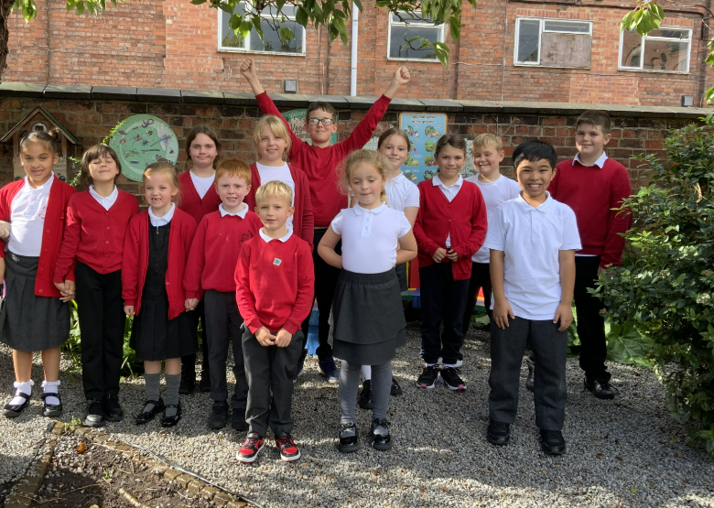
Holy Trinity School Council

Slide 2


How were we nominated?
To become a member of our School Council, you need to think carefully about how you could support school and be committed to the role.
We were required to present our own speeches, explaining to our classes why we would be able to represent them best and what we could do to share their voice.
We were then elected from a class vote, using our British value of democracy.

Slide 3
Who are we?
Our School Council is like a family. Our members have different roles and responsibilities, such as the Chair, Vice Chair, Secretary and Vice Secretary but we are all responsible and work together as a team to organise different charity events for the school throughout the year.
We create and present whole school assemblies on a number of different topics to raise awareness too. In the past, this has included Diversity week, including Anti-Bullying week and Children in Need.
School Council work together to help others in school.
We are the voice of the children in our classes and we discuss their ideas and problems to make our school the best it can be!

Slide 4
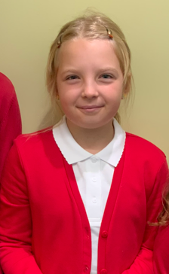
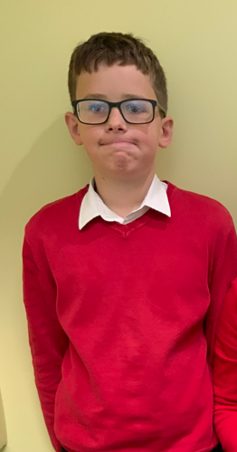
Our roles
The Vice Chair - Jakub
My role is to assist the Chair and take over when the Chair is absent.
The Chair - Nicola
My role in School Council is to lead the meetings and to make sure that everyone has an equal voice and can give their views.

Slide 5
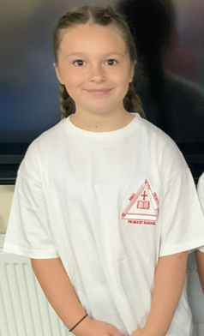
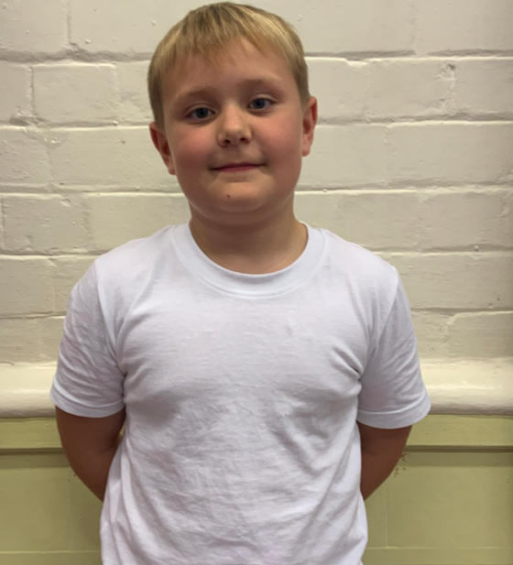
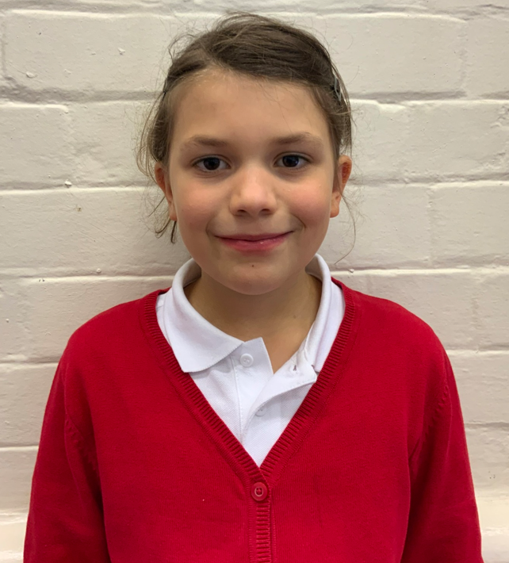
Our roles
Vice secretaries – Bailey and Adelaide
Our role is to assist the Secretary and to take over their role when they are absent from the meeting.
Secretary - Robyn
My role is to register who is at the meeting and to write down everything that is discussed.

Slide 6




Plans for the year
To organise Diversity week – including Anti-bullying week and raising money for Children in Need.
To raise money for Comic Relief
To help with play at lunchtimes
To help others in school
To be a voice for our school

Slide 7
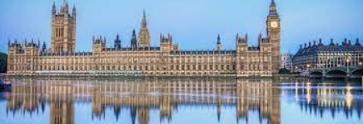
Questions we have…
What is your job in Parliament?
Why do you work in Parliament?
How were you nominated into Parliament?
Do you enjoy your job? What is the best thing about it?
How far away do you have to travel?
What does it look like in Parliament?
What’s the most important thing you do for Parliament?

Slide 8

Let us say our school prayer
We aspire to be more
We aspire to build a strong global community
We aspire to make the world a better place
We are part of the Holy Trinity family, we grow together
God give us the strength, love and courage to be more.
Amen
Thank you for listening and for answering our questions.

